Slide 1



Web Development Tools
Tools for Front-End Developers
Writing HTML and CSS Code
Svetlin Nakov
Technical Trainer
www.nakov.com
Software University
http://softuni.bg

Slide 2

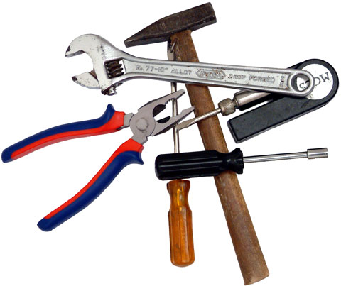



Table of Contents
Coding Tools
Text Editors
IDEs
Browser Tools
Drawing and Slicing Tools

Slide 3


Text Editors with HTML & CSS Support
Notepad++ (Windows)
GEdit (Linux)

Slide 4




IDEs for HTML, CSS and JS
Visual Studio / Visual Web Developer
Microsoft Web Matrix
Eclipse
Sublime Text
Brackets
Aptana Studio
WebStorm
Adobe Edge
Adobe Dreamweawer

Slide 5
Zen Coding / Emmet
Emmet (formerly Zen Coding) is a shortcut syntax for speed-writing HTML and CSS, e.g.
Learn more at http://emmet.io
Download plugin for your IDE
<div>
<dl>
<dt></dt>
<dd></dd>
<dt></dt>
<dd></dd>
<dt></dt>
<dd></dd>
</dl>
</div>
<footer>
<p></p>
</footer>
(div>dl>(dt+dd)*3)+footer>p

Slide 6





Browsers and Browser Tools
Google Chrome
Web Developer Toolbar
Mozilla Firefox
Firebug
Web inspector
Internet Explorer
F12
Opera
Inspect Element
Safari

Slide 7




Drawing and Slicing Tools
Adobe Photoshop
Adobe Fireworks
Paint.NET
GIMP

Slide 8





Source Control Systems
Git
GitHub
SVN

Slide 9
Web Development Tools
https://softuni.bg/courses/web-fundamentals/

Slide 10
License
This course (slides, examples, demos, videos, homework, etc.) is licensed under the "Creative Commons Attribution-NonCommercial-ShareAlike 4.0 International" license
Attribution: this work may contain portions from
"HTML Basics" course by Telerik Academy under CC-BY-NC-SA license
"CSS Styling" course by Telerik Academy under CC-BY-NC-SA license

Slide 11







SoftUni Diamond Partners

Slide 12





Free Trainings @ Software University
Software University Foundation – softuni.org
Software University – High-Quality Education, Profession and Job for Software Developers
softuni.bg
Software University @ Facebook
facebook.com/SoftwareUniversity
Software University @ YouTube
youtube.com/SoftwareUniversity
Software University Forums – forum.softuni.bg

